Slide 1


Unsupervised Learning (PCA and k-Means) Week 7
Machine Learning for Data Analysis MSc in Data Analytics CCT College Dublin
Lecturer: Dr. Muhammad Iqbal*
Email: miqbal@cct.ie
©CCT College Dublin 2022

Slide 2
Agenda
Introduction to Unsupervised Learning
Principle Component Analysis (PCA)
Reducing Dimensionality of Data
Clustering
Clustering Criterion: Elbow Method and The Silhouette Method
Types of Clustering
Feature Extraction Example
Comparison of PCA and Kmeans Clustering
Notes:
Manifold learning is an approach to non-linear dimensionality reduction. Algorithms for this task are based on the idea that the dimensionality of many data sets is only artificially high.

Slide 3
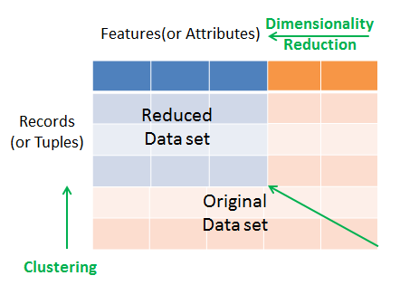
Introduction to Unsupervised Learning
Unsupervised learning means learning by observation, not by example or labeled data. This type of learning works with unlabelled data. Dimensionality reduction and clustering are examples of such learning.
Dimensionality reduction is used to reduce a large number of attributes to a few that can produce the same results.
There are several methods that are available for reducing the dimensionality of data, such as principal component analysis (PCA), t-SNE, wavelet transformation, and attribute subset selection.
The term cluster means a group of similar items that are closely related to each other.
We can say that a cluster is a set of data points that are similar to others in its cluster and dissimilar to data points of other clusters.
Clustering has numerous applications, such as in searching documents, business intelligence, information security, and recommender systems.
we can see how clustering puts data records or observations into a few groups, and dimensionality reduction reduces the number of features or attributes.
Notes:
t-distributed stochastic neighbor embedding: t-distributed stochastic neighbor embedding is a statistical method for visualizing high-dimensional data by giving each datapoint a location in a two or three-dimensional map.

Slide 4
Introduction to Unsupervised Learning
Suppose you are watching a sports match involving a ball on a flat screen TV. The TV probably contains a million pixels, and the ball is represented by, say, a thousand pixels.
In most sports, we are concerned with the position of the ball at a given time. For your brain to follow what’s going on, you need to follow the position of the ball on the playing field. You do this naturally, without even thinking about it.
Behind the scene, you are converting the million pixels on the monitor into a three-dimensional image showing the ball’s position on the playing field, in real time.
You have reduced the data from one million dimensions to three. In this sports match example, you are presented with millions of pixels, but it’s the ball’s three-dimensional position that’s important. This is known as dimensionality reduction.
You are reducing data from more than one million values to the three relevant values. It is much easier to work with data in fewer dimensions.
We have to identify relevant features before we can begin to apply machine learning algorithms.

Slide 5
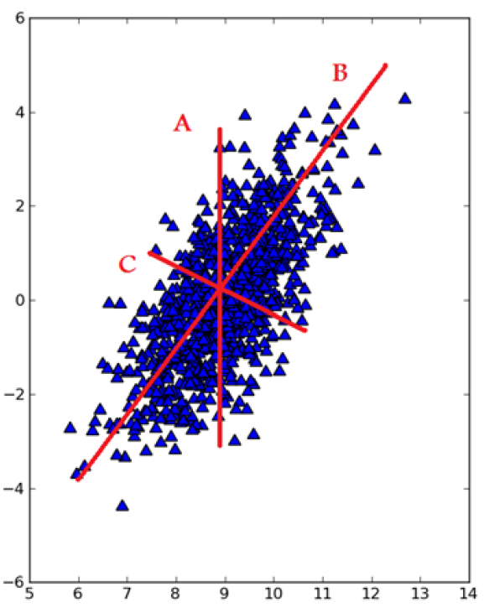
Principle Component Analysis (PCA)
The first method for dimensionality reduction is called principal component analysis (PCA).
In PCA, the dataset is transformed from its original coordinate system to a new coordinate system.
The new coordinate system is chosen by the data itself. The first new axis is chosen in the direction of the most variance in the data.
The second axis is orthogonal to the first axis and in the direction of an orthogonal axis with the largest variance.
This procedure is repeated for as many features as we had in the original data.
We find that the majority of the variance is contained in the first few axes. Therefore we can ignore the rest of the axes, and we reduce the dimensionality of our data.
Three choices for lines that span the entire dataset. Line B is the longest and accounts for the most variability in the dataset.

Slide 6
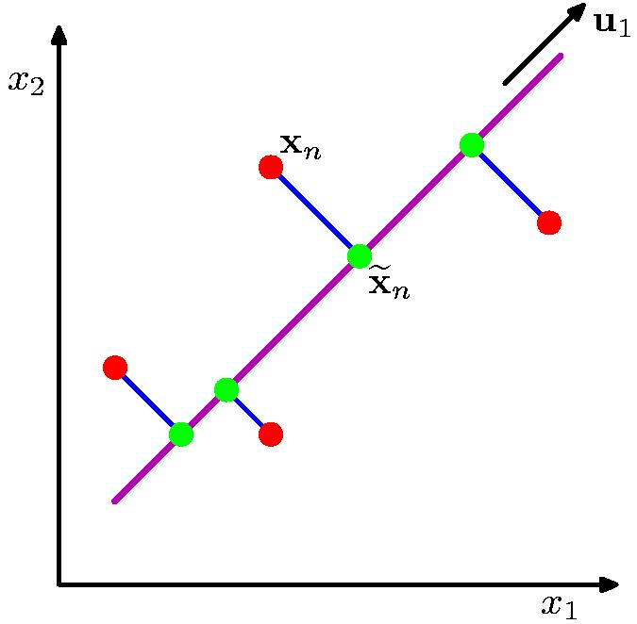
Reducing Dimensionality of Data
Dimensionality Reduction entails scaling down a large number of attributes or columns (features) into a smaller number of attributes.
The main objective of this technique is to get the best number of features for classification, regression, and other unsupervised approaches.
Techniques for linear transformations include PCA, Linear Discriminant analysis (LDA), and Factor Analysis.
Non-linear transformations include techniques such as t-SNE, Hessian eigenmaps and isometric feature mapping. Dimensionality reduction offers the following benefits
It filters redundant and less important features.
It reduces model complexity with less dimensional data.
It reduces memory and computation costs for model generation.
It visualizes high-dimensional data.
Maximizes the variance of the projected line (purple).
Minimizes the MSE between the data points and projections (blue).
Notes:
Linear discriminant analysis (LDA) is also closely related to principal component analysis (PCA) and factor analysis in that they both look for linear combinations of variables which best explain the data. LDA explicitly attempts to model the difference between the classes of data. Linear discriminant analysis has continuous independent variables and a categorical dependent variable (i.e. the class label).
Source: https://en.wikipedia.org/wiki/Linear_discriminant_analysis
Factor analysis is a technique that is used to reduce a large number of variables into fewer numbers of factors. This technique extracts maximum common variance from all variables and puts them into a common score. As an index of all variables, we can use this score for further analysis. Factor analysis is part of general linear model (GLM) and this method also assumes several assumptions: there is linear relationship, there is no multicollinearity, it includes relevant variables into analysis, and there is true correlation between variables and factors. Several methods are available, but principal component analysis is used most commonly.
Source: https://www.statisticssolutions.com/free-resources/directory-of-statistical-analyses/factor-analysis/
t-distributed stochastic neighbor embedding (t-SNE) is a statistical method for visualizing high-dimensional data by giving each datapoint a location in a two or three-dimensional map. Specifically, it models each high-dimensional object by a two- or three-dimensional point in such a way that similar objects are modeled by nearby points and dissimilar objects are modeled by distant points with high probability.
Hessian eigenmaps or Locally linear embedding (LLE) seeks a lower-dimensional projection of the data which preserves distances within local neighborhoods. It can be thought of as a series of local Principal Component Analyses which are globally compared to find the best non-linear embedding.
Feature Mapping is an interactive classification process that can be applied to any aerial or satellite multiband imagery, from high-quality hyperspectral to poor-quality airvideo. Using Feature Mapping's interactive tools, you can analyze any number of bands to identify, mark, and measure feature classes.
Isomap is a nonlinear dimensionality reduction method. It is one of several widely used low-dimensional embedding methods. Isomap is used for computing a quasi-isometric, low-dimensional embedding of a set of high-dimensional data points. The algorithm provides a simple method for estimating the intrinsic geometry of a data manifold based on a rough estimate of each data point’s neighbors on the manifold. Isomap is highly efficient and generally applicable to a broad range of data sources and dimensionalities.

Slide 7
Principle Component Analysis (PCA)
In machine learning, it is considered that having a large amount of data means having a good-quality model for prediction, but a large dataset also poses the challenge of higher dimensionality.
It causes an increase in complexity for prediction models due to the large number of attributes.
For example, if we have 200 attributes or columns in our data, it becomes very difficult for us to proceed, what with such a huge number of attributes. In such cases, we need to reduce that number to 10 or 20 variables.
Another objective of PCA is to reduce the dimensionality without affecting the significant information. For p-dimensional data, the PCA equation can be written as follows
Principal Components are a weighted sum of all the attributes. Here, are the attributes in the original dataset and are the weights of the attributes.

Slide 8
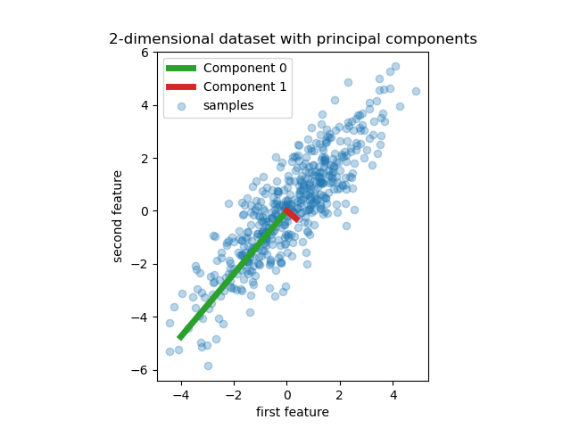
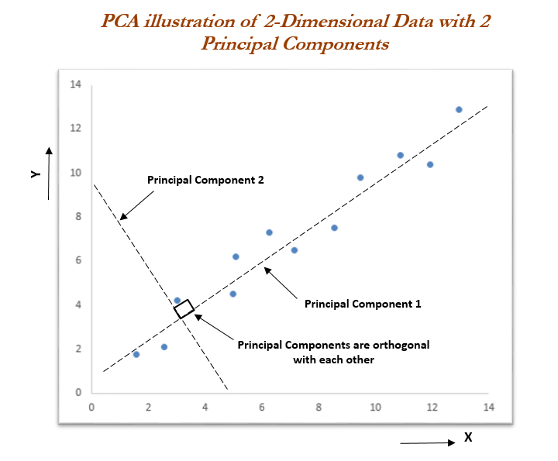

Principle Component Analysis Example
Suppose we consider the streets in a given city as attributes, and let's say you want to visit this city. Now the question is, how many streets you will visit? Obviously, you would like to visit the popular or main streets of the city, which let's say is 10 out of the 50 available streets. These 10 streets will give you the best understanding of that city. These streets are principal components, as they explain enough of the variance in the data (the city's streets).
Performing PCA
Compute the correlation or covariance matrix of a given dataset.
Find the eigenvalues and eigenvectors of the correlation or covariance matrix.
Multiply the eigenvector matrix by the original dataset and you will get the principal component matrix.
Notes:
Step 1: Data Preparation
Step 2: Standardize the Data
Step 3: Calculate the Covariance Matrix
Step 4: Compute Eigenvectors and Eigenvalues
Step 5: Sort Eigenvectors and Eigenvalues
Step 6: Select Principal Components
Step 7: Create the Projection Matrix
Step 8: Project the Data
Step 9: Interpret the Results
Step 10: Use the Reduced-Dimension Data

Slide 9
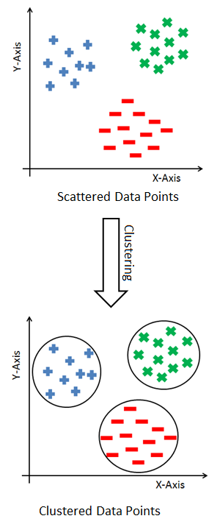
Clustering
Finding groups of objects such that the objects in a group will be similar (or related) to one another and different from (or unrelated to) the objects in other groups.
Grouping similar products, grouping similar articles or documents, and grouping similar customers for market segmentation are all examples of clustering.
The core principle of clustering is minimizing the intra-cluster distance and maximizing the inter-cluster distance.
The intra-cluster distance is the distance between data items within a group, and the inter-cluster distance is the distance between different groups.
Since the data points are not labeled, so clustering is a kind of unsupervised problem.
There are various methods for clustering and each method uses a different way to group the data points.
Intra-cluster distances are minimized
Inter-cluster distances are maximized

Slide 10



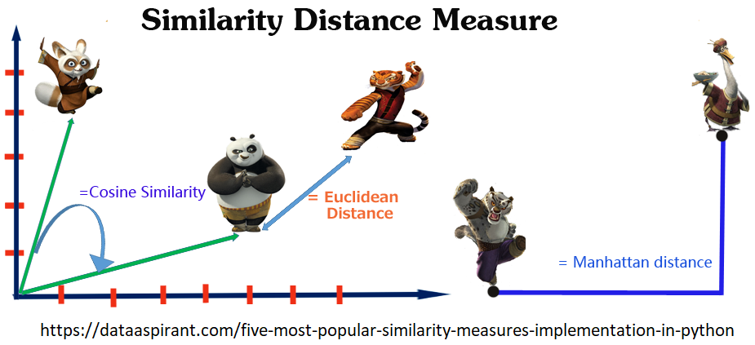
Clustering Criterion
When we are combining similar data points, the question that arises is how to find the similarity between two data points so we can group similar data objects into the same cluster.
In order to measure the similarity or dissimilarity between data points, we can use distance measures such as Euclidean, Manhattan, and Minkowski distance.
Where the distance formula calculates the distance between two k-dimensional vectors, x_{i} and y_{i}.
We know what clustering is, but the most important question is, how many numbers of clusters should be considered when grouping the data?
This is the biggest challenge for most clustering algorithms.

Slide 11
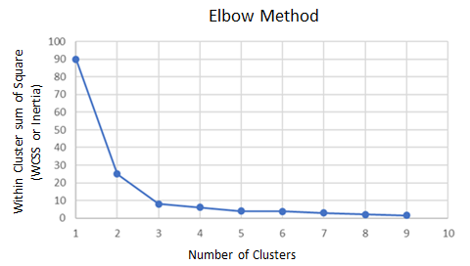
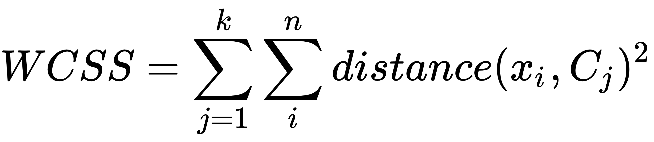
Finding Number of Clusters
We focus on the most fundamental issue of clustering algorithms, which is discovering the number of clusters in a dataset. In k-means clustering, we need to define the number of clusters. Selecting the right value for the number of clusters is tricky. We can use two methods to decide the number of clusters
The elbow method
The elbow method is a well-known method for finding out the best number of clusters.
In this method, we focus on the percentage of variance for the different numbers of clusters. The core concept of this method is to select the number of clusters that appending another cluster should not cause a huge change in the variance. The sum of squares is also known as the Within-Cluster Sum of Squares (WCSS) or inertia.
We can plot a graph for the sum of squares within a cluster using the number of clusters to find the optimal value.
As we can see, at k = 3, the graph begins to flatten significantly, so we would choose 3 as the number of clusters.
Where C_{j} is the cluster centroid and x_{i} is the data points in each cluster.

Slide 12
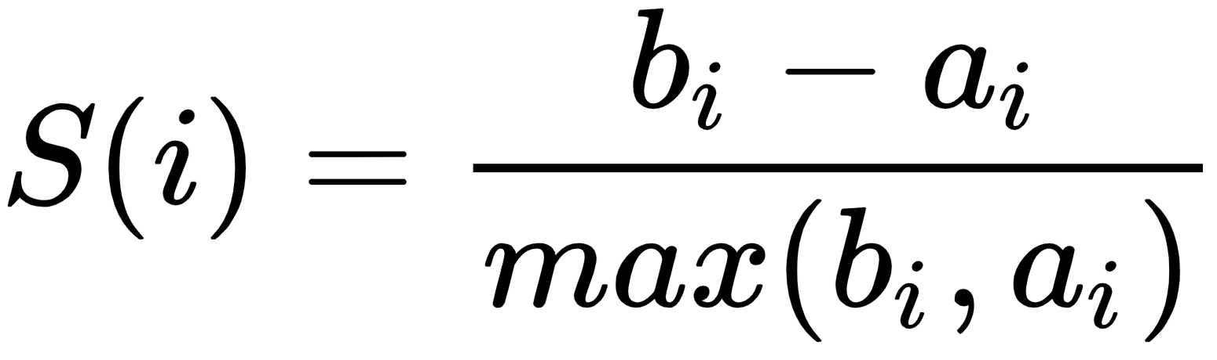
The Silhouette Method
The silhouette method assesses and validates cluster data. It finds how well each data point is classified. The plot of the silhouette score helps us to visualize and interpret how well data points are tightly grouped within their own clusters and separated from others. It helps us to evaluate the number of clusters. Its score ranges from -1 to +1.
A positive value indicates a well-separated cluster and a negative value indicates incorrectly assigned data points.
The more positive the value, the further data points are from the nearest clusters; a value of zero indicates data points that are at the separation line between two clusters. Let's see the formula for the silhouette score
a_{i} is the average distance of the i^{th} data point from other points within the cluster.
b_{i} is the average distance of the i^{th} data point from other cluster points.
This means we can easily say that S(i) would be between [-1, 1]. So, for S(i) to be near to 1, a_{i} must be very small compared to b_{i}, that is, a_{i} << b_{i}.

Slide 13
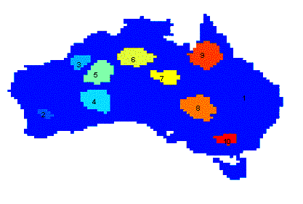
What is not Cluster Analysis?
Applications of Cluster Analysis
Simple segmentation
Dividing students into different registration groups alphabetically, by last name
Results of a query
Groupings are a result of an external specification
Clustering is a grouping of objects based on the data using some algorithm
Supervised classification
Have class label information
Association Analysis
Local vs. global connections
Clustering precipitation in Australia

Slide 14
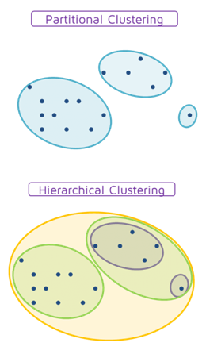
Types of Clustering
A clustering is a set of clusters.
Important distinction between hierarchical and partitional sets of clusters.
Partitional Clustering
A division of data objects into non-overlapping subsets (clusters), such that each data object is in exactly one subset.
Hierarchical Clustering
A set of nested clusters organized as a hierarchical tree.

Slide 15
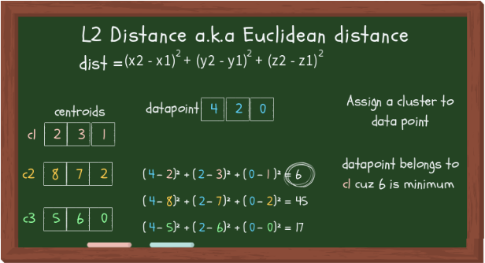
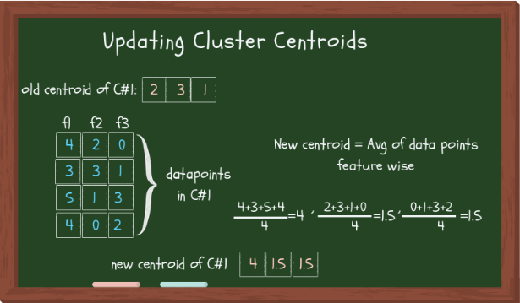
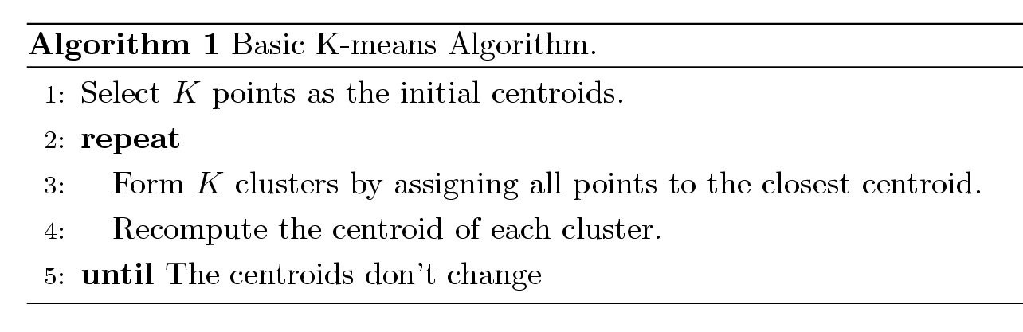
KMeans Clustering
Partitional clustering approach
Number of clusters, K, must be specified
Each cluster is associated with a centroid (center point)
Each point is assigned to the cluster with the closest centroid
The basic algorithm is very simple

Slide 16
K-means Clustering Example
Initial centroids are chosen randomly.
Clusters produced vary from one run to another.
The centroid is (typically) the mean of the points in the cluster.
‘Closeness’ is measured by Euclidean distance, cosine similarity, correlation, etc.
K-means will converge for common similarity measures as mentioned previously.
Most of the convergence happens in the first few iterations.
Often the stopping condition is changed to ‘Until relatively few points change clusters’
Complexity is O( n * K * I * d )
n = number of points, K = number of clusters, I = number of iterations, d = number of attributes

Slide 17
K-means Clustering Example

Slide 18
Evaluating K-means Clusters
Most common measure is Sum of Squared Error (SSE)
For each point, the error is the distance to the nearest cluster
To get SSE, we square these errors and sum them.
x is a data point in cluster C_{i} and m_{i} is the representative point for cluster C_{i}
can show that m_{i} corresponds to the center (mean) of the cluster
Given two sets of clusters, we prefer the one with the smallest error
One easy way to reduce SSE is to increase K, the number of clusters
A good clustering with smaller K can have a lower SSE than a poor clustering with higher K

Slide 19
Two different K-means Clustering
Original Points
Limitations of K-means
K-means has problems when clusters are of differing
Sizes
Densities
Non-globular shapes
K-means has problems when the data contains outliers.
Optimal Clustering
Sub-optimal Clustering

Slide 20
Solutions to Initial Centroids Problem
Multiple runs
Helps, but probability is not on your side
Sample and use hierarchical clustering to determine initial centroids
Select more than K initial centroids and then select among these initial centroids
Select most widely separated
Post-processing
Generate a larger number of clusters and then perform a hierarchical clustering
Bisecting K-means
Not as susceptible to initialization issues

Slide 21
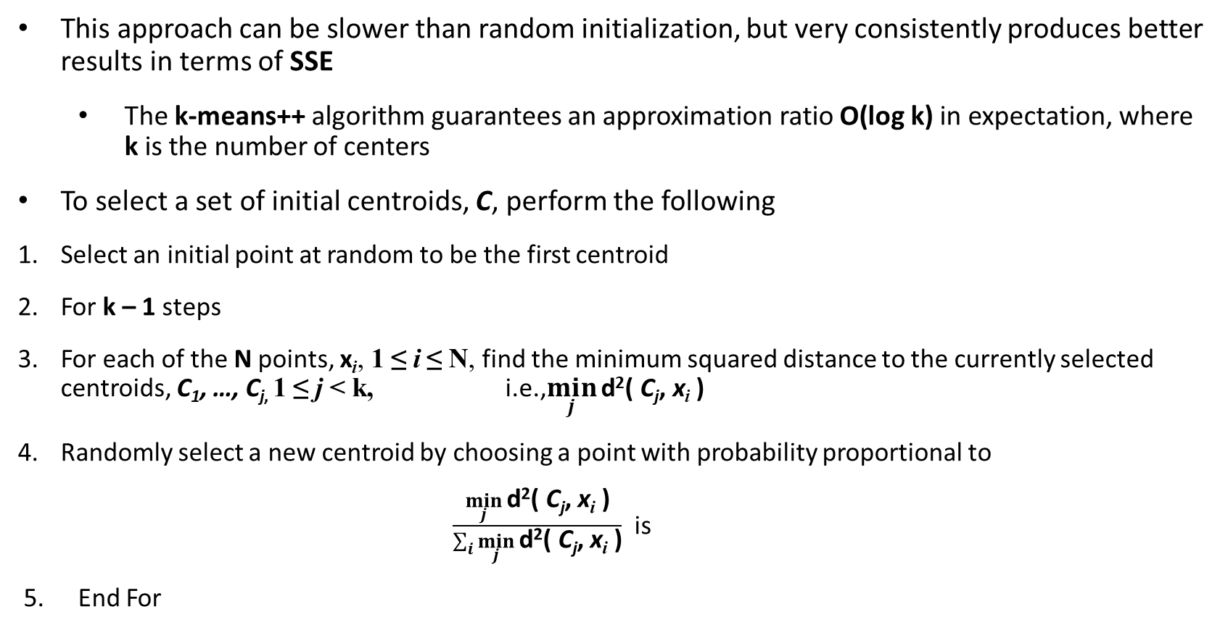
K-means++
This approach can be slower than random initialization, but very consistently produces better results in terms of SSE
The k-means++ algorithm guarantees an approximation ratio O(log k) in expectation, where k is the number of centers
To select a set of initial centroids, C, perform the following
Select an initial point at random to be the first centroid
For k – 1 steps
For each of the N points, x_{i}, 1 ≤ i ≤ N, find the minimum squared distance to the currently selected centroids, C₁, …, C_{j,} 1 ≤ j < k, i.e.,$\min_{j}{\text{d}\text{2}\text{( }\text{C}\text{j}\text{, }\text{x}\text{i}\text{ )}}$
Randomly select a new centroid by choosing a point with probability proportional to
$\frac{\min_{j}{\text{d}\text{2}\text{( }\text{C}\text{j}\text{, }\text{x}\text{i}\text{ )}}}{\sum_{i}{\min_{j}{\text{d}\text{2}\text{( }\text{C}\text{j}\text{, }\text{x}\text{i}\text{ )}}}}$ is
End For

Slide 22
Updating Centers Incrementally
In the basic K-means algorithm, centroids are updated after all points are assigned to a centroid.
An alternative is to update the centroids after each assignment (incremental approach)
Each assignment updates zero or two centroids
More expensive
Introduces an order dependency
Never get an empty cluster
Can use “weights” to change the impact

Slide 23
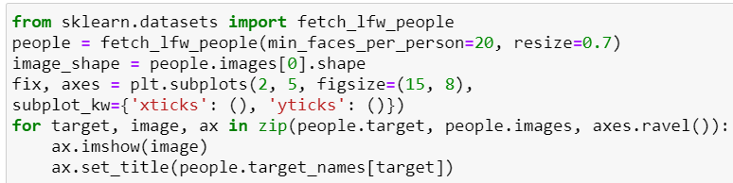
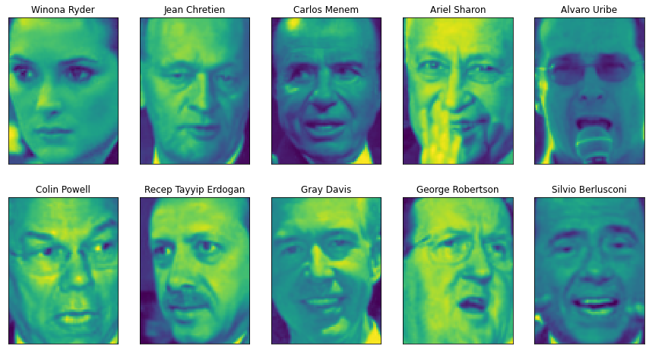

Feature Extraction Application
A great example of an application where feature extraction is helpful with images. Images are made up of pixels, usually stored as red, green, and blue (RGB) intensities.
Objects in images are made up of thousands of pixels, and only together are they meaningful.
We give a very simple application of feature extraction on images using PCA, by working with face images from the Labeled Faces in the Wild dataset.
This dataset contains face images of celebrities downloaded from the Internet, and it includes faces of politicians, singers, actors, and athletes from the early 2000s.
We use grayscale versions of these images, and scale them down for faster processing. We can see some of the images in Figure.
There are 3,023 images, each 87×65 pixels large, belonging to 62 different people
https://scikit-learn.org/stable/modules/generated/sklearn.datasets.fetch_lfw_people.html

Slide 24
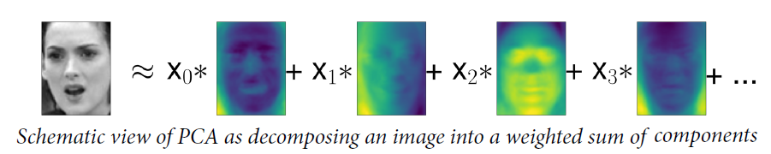
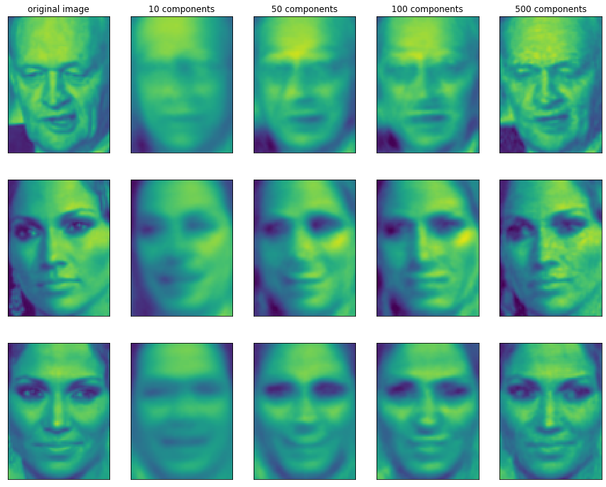
Feature Extraction Application
We can see that when we use only the first 10 principal components, only the essence of the picture, like the face orientation and lighting, is captured.
By using more and more principal components, more and more details in the image are preserved.
This corresponds to extending the sum in Figure to include more and more terms.
Using as many components as there are pixels would mean that we would not discard any information after the rotation, and we would reconstruct the image perfectly.
Reconstructing three face images using increasing numbers of principal components
Notes:
Let’s consider a specific case of PCA. We introduced the PCA transformation as rotating the data and then dropping the components with low variance.
Another useful interpretation is to find some numbers (the new feature values after the PCA rotation) so that we can express the test points as a weighted sum of the principal components.
Here, x₀, x₁, and so on are the coefficients of the principal components for this data point; in other words, they are the representation of the image in the rotated space.

Slide 25
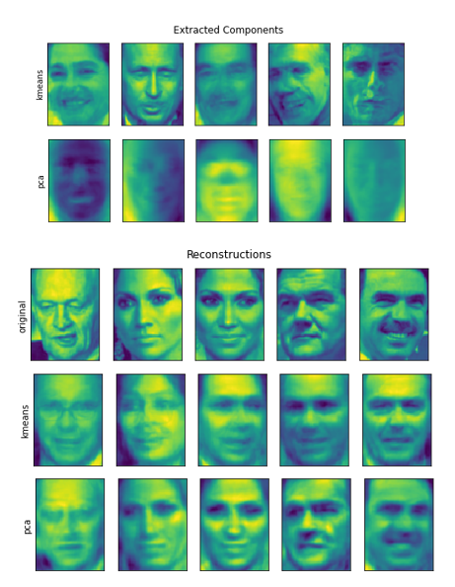
Comparison of PCA and K-means
Although k-means is a clustering algorithm, there are interesting parallels between k-means and the decomposition methods like PCA.
PCA tries to find directions of maximum variance in the data, while k-means tries to represent each data point using a cluster center.
We can think of that as each point being represented using a single component, which is given by the cluster center.
This view of k-means as a decomposition method, where each point is represented using a single component, is called vector quantization.
Lets compare PCA and k-means outcomes, showing the components extracted, as well as reconstructions of faces from the test set using 100 components.
An interesting aspect of vector quantization using k-means is that we can use many more clusters than input dimensions to encode our data.
Comparing image reconstructions using k-means and PCA with 100 components (or cluster centers)—k-means uses only a single cluster center per image

Slide 26
Resources/ References
Introduction to Data Mining, 2nd Edition, Pang-Ning Tan, Michael Steinbach, Anuj Karpatne, Vipin Kumar, 2019, Pearson.
Introduction to Machine Learning with Python A Guide for Data Scientists, Andreas C. Müller and Sarah Guido, Copyright © 2017, O'Reilly.
Machine Learning with Python Cookbook: Practical Solutions from Preprocessing to Deep Learning Paperback – 23 Mar. 2018. by. Chris Albon
https://pub.towardsai.net/principal-component-analysis-pca-with-python-examples-tutorial-67a917bae9aa#2000
Numerical Computing with Python, Pratap Dangeti, Allen Yu, Claire Chung, Aldrin Yim, Packt Publishing, 2018.
https://towardsdatascience.com/k-means-clustering-from-a-to-z-f6242a314e9a
Copyright Notice The following material has been communicated to you by or on behalf of CCT College Dublin in accordance with the Copyright and Related Rights Act 2000 (the Act). The material may be subject to copyright under the Act and any further reproduction, communication or distribution of this material must be in accordance with the Act. Do not remove this notice

